Slide 1
Computer Science
Not an Indian from YouTube

Slide 2
3 hours = 180 minutes

Slide 3
200 marks

Slide 4
10 short answer

Slide 5
8 extended answer

Slide 6
Various topics

Slide 7
Information Systems

Slide 8
Networks

Slide 9
Communications

Slide 10
Databases

Slide 11
Languages/Programming

Slide 12
Computer Architecture

Slide 13
Information Systems

Slide 14
Datum/Data

Slide 15
raw

Slide 16
unprocessed

Slide 17
not useful/lacks meaning

Slide 18
Information

Slide 19
transformed

Slide 20
processed

Slide 21
useful

Slide 22
Data
Information
Knowledge

Slide 23
System

Slide 24
Information Systems

Slide 25
set of related components that process input data into output data that is organised, meaningful and useful

Slide 26
Transaction Processing Systems

Slide 27
captures and processes data from day to day activities

Slide 28
batch processing

Slide 29
collect over time & process all transactions later

Slide 30
realtime processing

Slide 31
Don’t use with RAD

Slide 32
all transactions are done in real time

Slide 33
most today are online

Slide 34
Carriers

Slide 35
company that offers telecommunications between 2 points across the world

Slide 36
telstra

Slide 37
iinet

Slide 38
Service Providers

Slide 39
Provides a service to customers but doesn’t own the infrastructure

Slide 40
AAPT

Slide 41
westnet

Slide 42
System Development Life Cycle

Slide 43
1. Preliminary Investigation

Slide 44
Feasability Study

Slide 45
technical
legal
operational
Measure of how suitable system development will be to the company
economical
security

Slide 46
operational

Slide 47
how well it work?

Slide 48
will they like it?

Slide 49
will it meet user requirements?

Slide 50
schedule

Slide 51
deadlines for project

Slide 52
is it reasonable?

Slide 53
technical

Slide 54
hardware

Slide 55
software

Slide 56
people

Slide 57
economic

Slide 58
are the costs worth the benefits

Slide 59
tools

Slide 60
ROI (return on investment)

Slide 61
cost/benefit analysis

Slide 62
legal

Slide 63
Issues such as govt. regulations

Slide 64
community concerns

Slide 65
Analysis

Slide 66
data gathering techniques

Slide 67
observation

Slide 68
interview

Slide 69
survey

Slide 70
questionnaire

Slide 71
context diagram

Slide 72
data flow diagram (DFD)

Slide 73
packaged vs. custom software

Slide 74
convey all solutions

Slide 75
Select one

Slide 76
find errors early

Slide 77
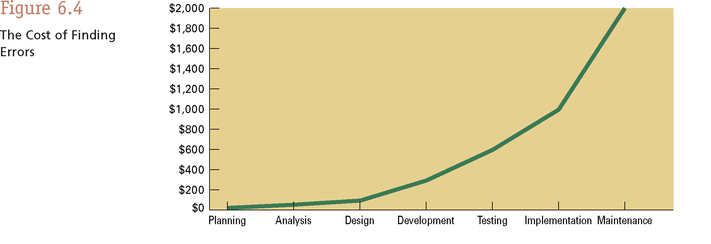

Slide 78
Design

Slide 79
identify technical specs

Slide 80
hardware

Slide 81
software

Slide 82
ERD

Slide 83
Prototyping

Slide 84
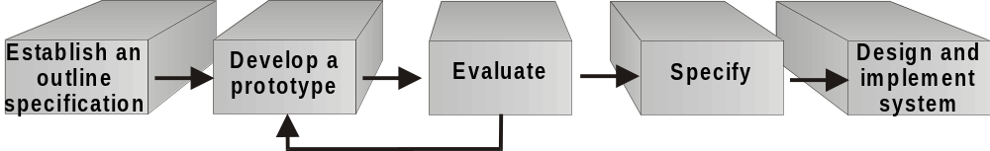
Prototyping

Slide 85
mock up of final design

Slide 86
user feedback

Slide 87
outputs from system

Slide 88
GUI (graphic user interface)

Slide 89
CASE tools

Slide 90
designed to assist in one or more activities in SDLC

Slide 91
Data dictionary

Slide 92
Development

Slide 93
write programs

Slide 94
test modules

Slide 95
Unit Test
Systems test
Verifies each individual program works by itself
Verifies all programs in application work together
Integration Test
Acceptance Test
Verifies application works with other applications
Verifies the new system works with actual data

Slide 96
finalise program

Slide 97
Implementation

Slide 98
test the system in real life

Slide 99
documentation

Slide 100
help manual

Slide 101
train users

Slide 102
conversion of files to new system

Slide 103
Implementation

Slide 104
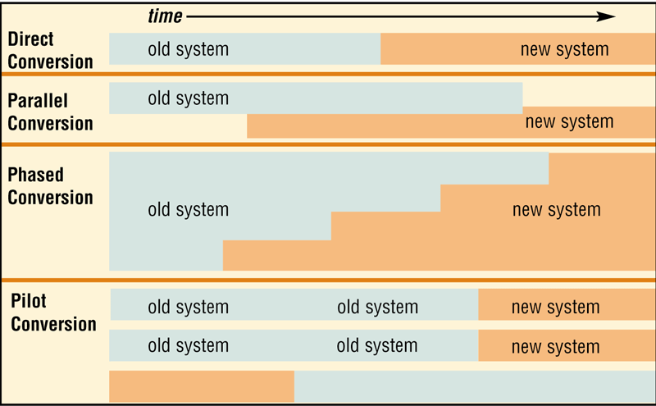
pilot
direct
parallel
phased

Slide 105
Pilot - start with small group of users and gradually add more users

Slide 106
Phased – implement the new system in phases

Slide 107
Parallel – use both systems simultaneously

Slide 108
Direct – out with the old and in with the new

Slide 109
Maintenance

Slide 110
66% of the cost of the project

Slide 111
perfective

Slide 112
implies that while it runs smoothly there is still room for improvement

Slide 113
adaptive

Slide 114
all systems will need to adapt to changing needs within a company

Slide 115
corrective

Slide 116
problems frequently come up after a period of time, no matter how thoroughly it has been tested

Slide 117
help desk

Slide 118
Context Diagrams

Slide 119
boundary system

Slide 121
external entity

Slide 123
data flow

Slide 125
Data Flow Diagram

Slide 126
entities

Slide 127
files

Slide 128
vectors

Slide 129
processes

Slide 130
ENTITIES

Slide 131
square

Slide 132
outside boundary

Slide 133
double line

Slide 134
must go through a process

Slide 135
FILE

Slide 136
open ended rectangle

Slide 137
what documents are we storing

Slide 138
must go through a process

Slide 139
VECTOR

Slide 140
what information is moving?

Slide 141
be specific

Slide 142
PROCESS

Slide 143
must be numbered

Slide 144
must begin with a verb

Slide 145
Information must be processed or changed

Slide 146
Top Down

Slide 147
general design & moves to a more detailed design

Slide 148
Bottom Up

Slide 149
Individual parts are specified in great detail first & then linked to form bigger system

Slide 150
Centralised Systems

Slide 151
information is processed in one location

Slide 152
all processing, software & hardware in one location as well

Slide 153
Distributed Systems

Slide 154
data processed without necessarily being connected to a central computer

Slide 155
although distributed, information is transferred to a central computer

Slide 156
Project Management

Slide 157
time management

Slide 158
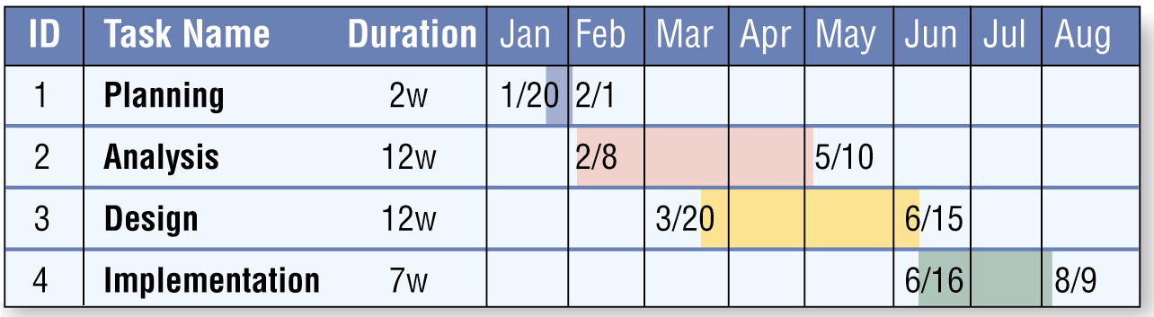
gantt chart

Slide 159
progress reports

Slide 160
team planning

Slide 161
work assignment

Slide 162
RAD
Fast tracks development of systems

Slide 163
RAD
Fast tracks development of systems

Slide 164
Databases

Slide 165
DBMS

Slide 166
program that allows a user to create a computerised database

Slide 167
Definition

Slide 168
collection of data organised in a manner that allows access for retrieval, and use of that data

Slide 169
What are the qualities of valuable information?
Accurate
Verifiable
Timely
Organized
Accessible
Useful
Cost-effective

Slide 170
Types

Slide 171
Flat File

Slide 172
Single table

Slide 173
spreadsheet like

Slide 174
lots of repeating data

Slide 175
Incorrect spelling of data

Slide 176
Relational

Slide 177
series of tables called relations

Slide 178
joined by keys

Slide 179
most commonly used

Slide 180
queries used to retrieve data entered

Slide 181
relation

Slide 182
a set of tuples that have the same attributes a table

Slide 183
atomic

Slide 184
single entry per cell

Slide 185
tuple

Slide 186
represents an object or information about that object a row

Slide 187
attribute

Slide 188
single piece of data shown in a column used by developers to refer to a field

Slide 189
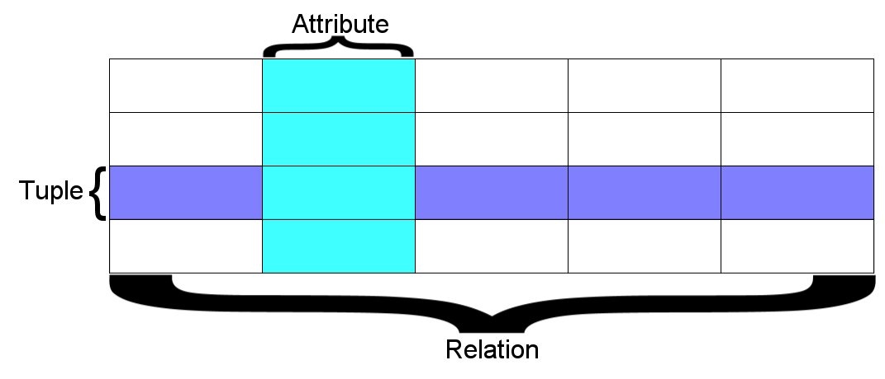
how does it fit together

Slide 190
Index

Slide 191
improves speed of queries in a database

Slide 192
Random

Slide 193
use labels or indexes to get to correct record

Slide 194
eg: if name is Jefferson, go to J, then Je in the phone book first rather than each name in the book beginning with ‘A’

Slide 195
Sequential

Slide 196
look at every record in order

Slide 197
very inefficient

Slide 198
humans wouldn’t do it, but computers have to be told

Slide 199
use random first, then sequential

Slide 200
Data Dictionary

Slide 201
An element that contains data about each file in a database and each field in the database

Slide 202
Keys

Slide 203
Primary

Slide 204
attribute in a database that uniquely identifies each tuple in a file

Slide 205
Foreign

Slide 206
a key from another table that is used to define a relationship to another record in another table

Slide 207
has the same name and properties as the primary key from which it is copied

Slide 208
Normalisation

Slide 209
1NF

Slide 210
There are no repeating groups

Slide 211
All the key attributes are defined

Slide 212
All attributes are dependent on the primary key

Slide 213
2NF

Slide 214
Its in first normal form

Slide 215
It includes no partial dependencies (where an attribute is dependent on only part of a primary key)

Slide 216
3NF

Slide 217
Its in 2nd normal form

Slide 218
It has no transitive dependencies (where a non-key attribute is dependent on another non-key attribute)

Slide 219
ER Diagram

Slide 220
Entity

Slide 222
Relationship

Slide 224
Queries

Slide 225
Know how to create them

Slide 226
data warehouse

Slide 227
repository of an organisations electronically stored data

Slide 228
designed to facilitate reporting and analysis

Slide 229
data marts

Slide 230
subset of an organised data store

Slide 231
tends to focus on specific business functions

Slide 232
Data mining

Slide 233
process of extracting patterns from data

Slide 234
used in a wide range of fields

Slide 235
Data Warehouse

Slide 236
Data Warehouse

Slide 237
a large store of data accumulated from a wide range of sources within a company and used to guide management decisions.

Slide 238
Smaller version of a data warehouse

Slide 239
cheaper

Slide 240
SQL

Slide 241
select

Slide 242
from

Slide 243
where

Slide 244
order by

Slide 245
Use join and the 2 keys if 2 tables present

Slide 246
SELECT *
FROM Book
WHERE price > 100.00
ORDER BY title;

Slide 247
Networks

Slide 248
Routers

Slide 249
Connect 2 LANS

Slide 250
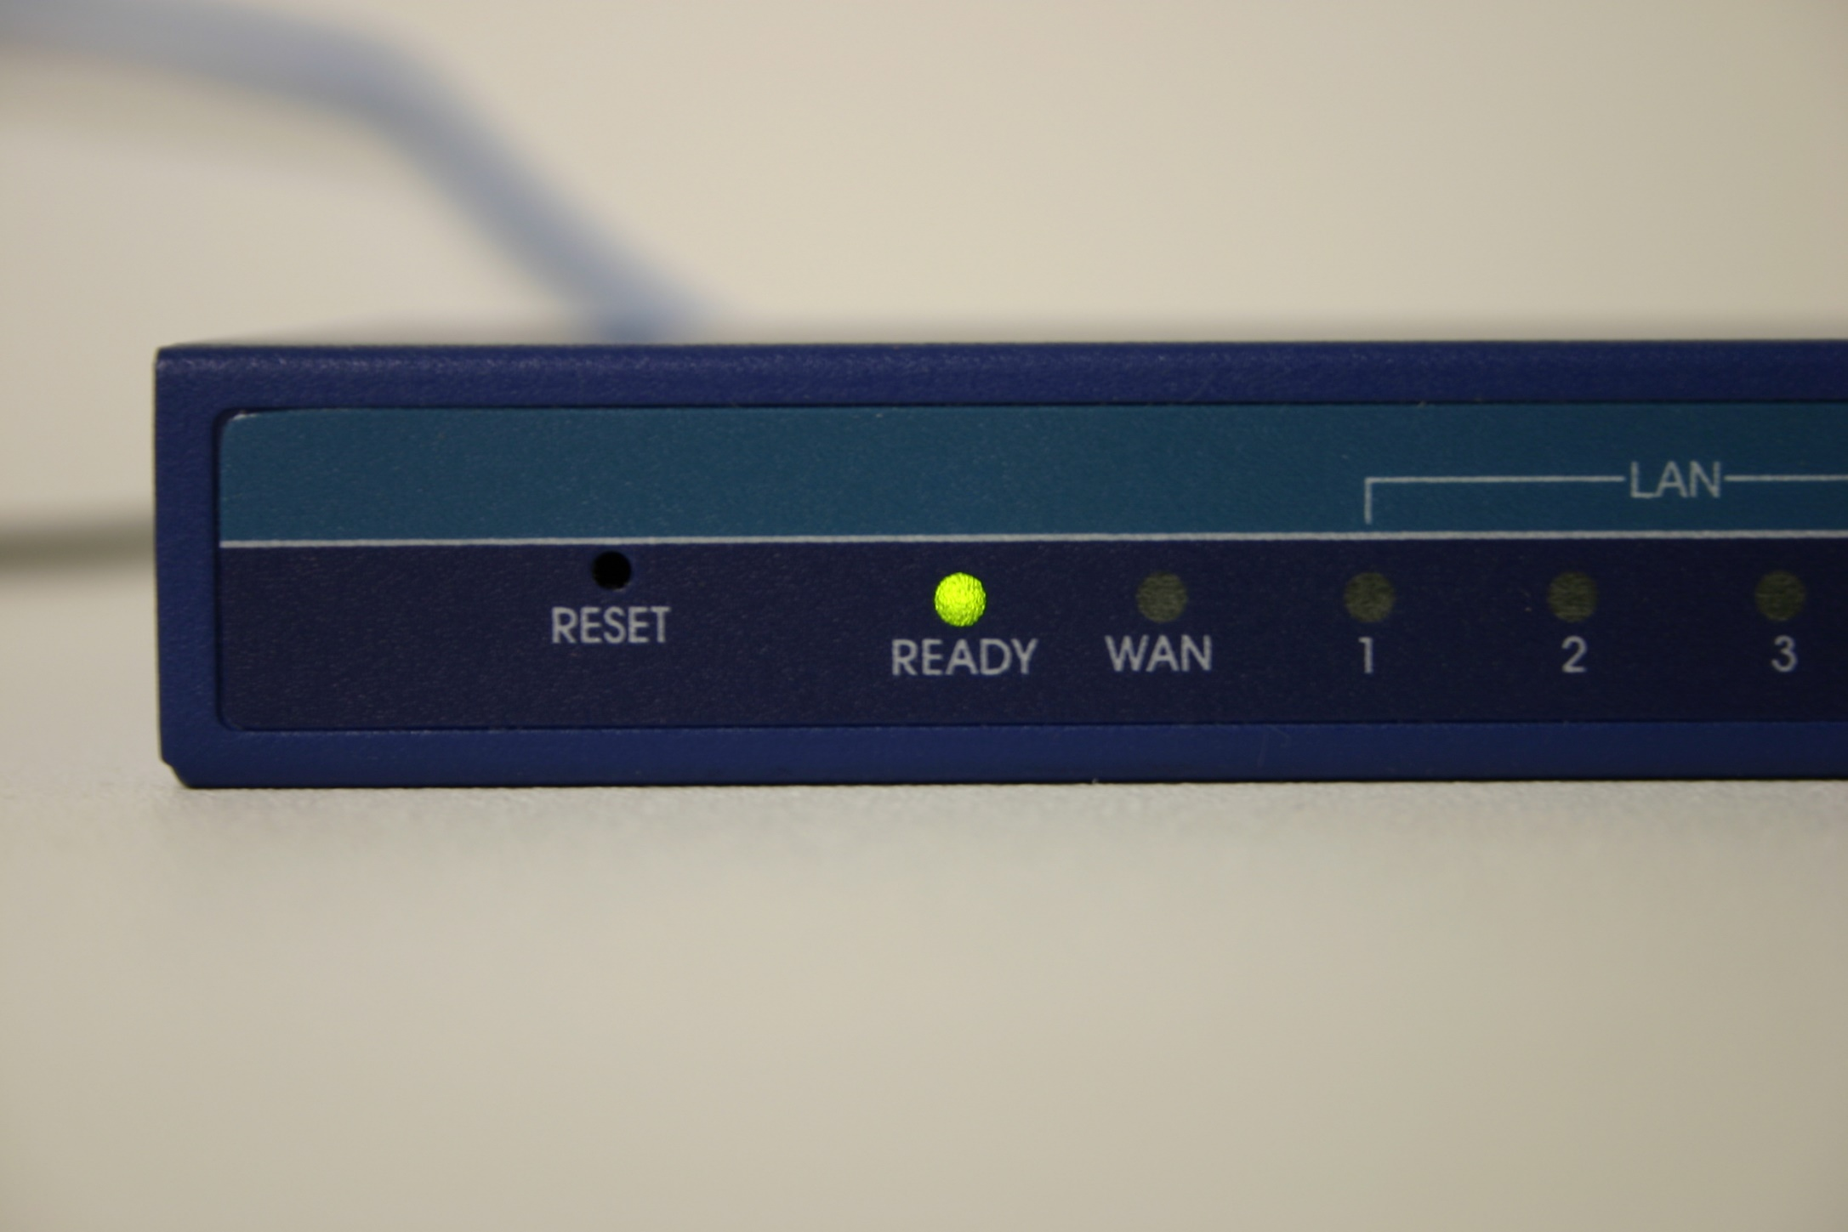
Connect 2 LANS

Slide 251
Similar to bridges but added functionality such as filtering messages

Slide 252
Widely used on the net

Slide 253
Switches

Slide 254
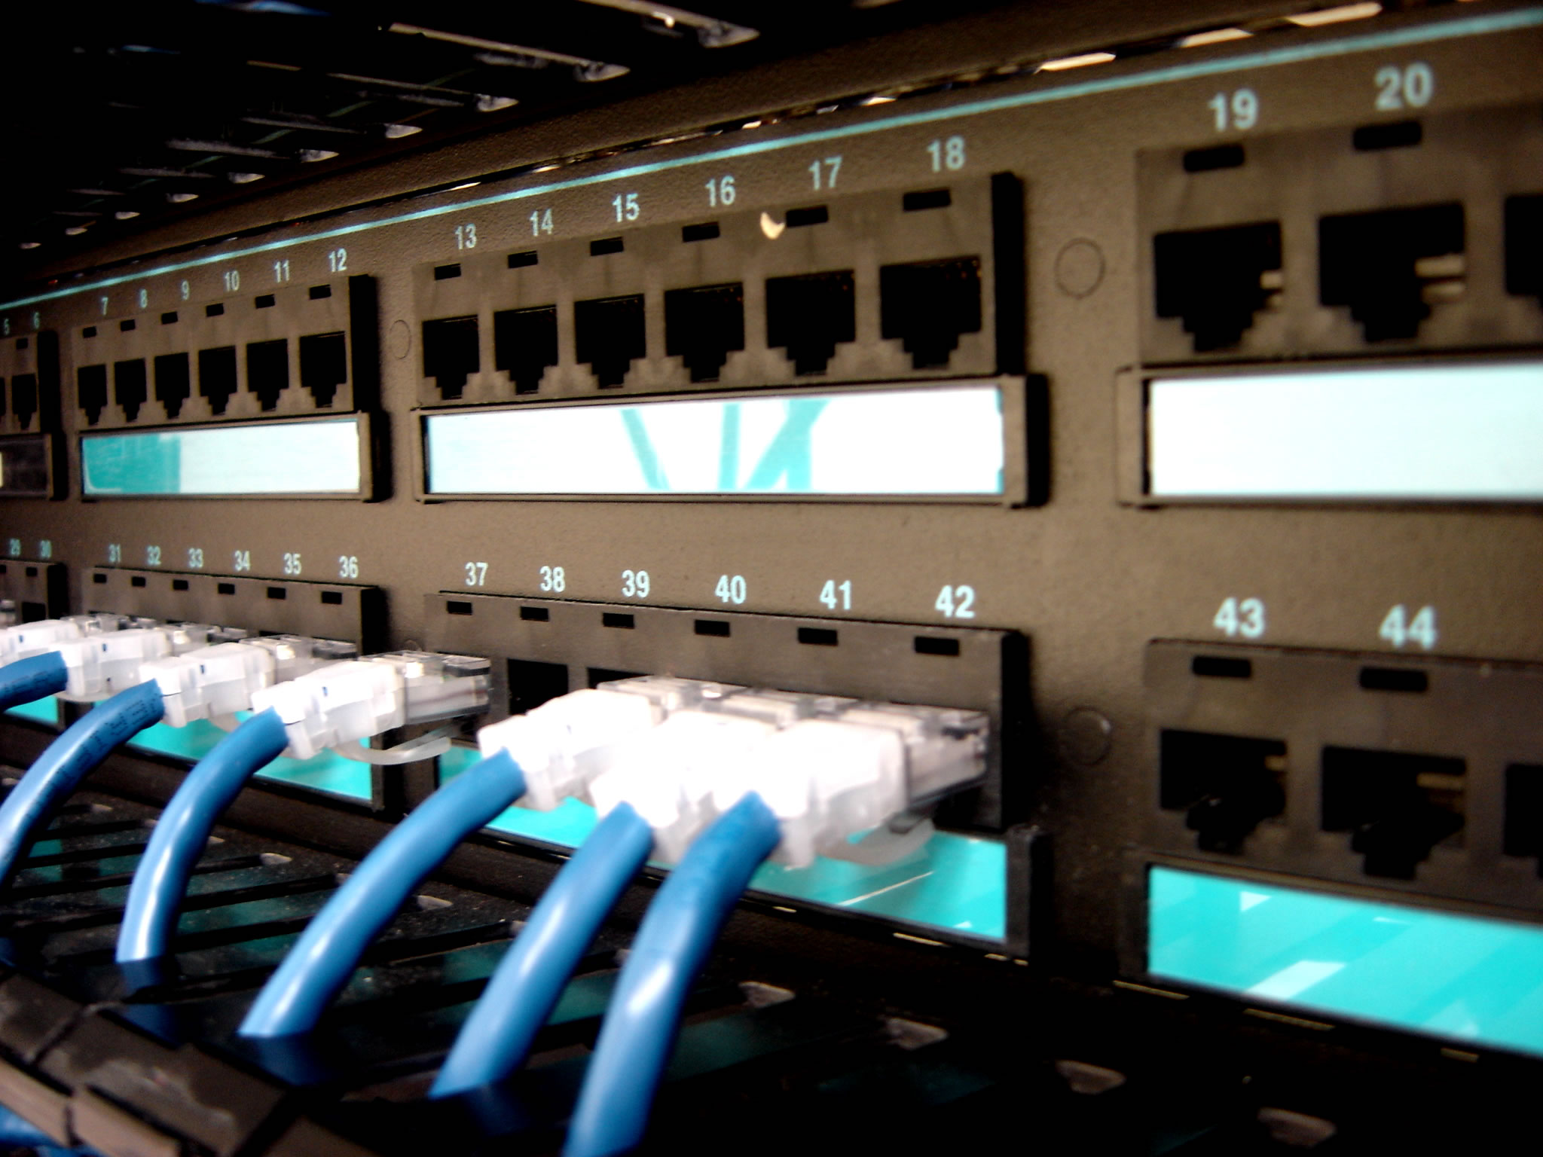

Slide 255
Central device that provides common connection point for nodes on a network

Slide 256
smart

Slide 257
Bridge

Slide 258
Connects 2 LANS

Slide 259
Can connect different types of LANS

Slide 260
Protocol-independent

Slide 261
Forward packets without analysing or re-routing messages

Slide 262
Faster than routers but less versatile

Slide 263
Distributed information processing

Slide 264
Parts of the total system is processed by multiple computers

Slide 265
Distributed geographical locations

Slide 266
centralised information processing

Slide 267
central location

Slide 268
data security

Slide 269
viruses

Slide 270
worms

Slide 271
trojan

Slide 272
firewall

Slide 273
Security system consisting of hardware and/or software that prevents unauthorized intrusion

Slide 274
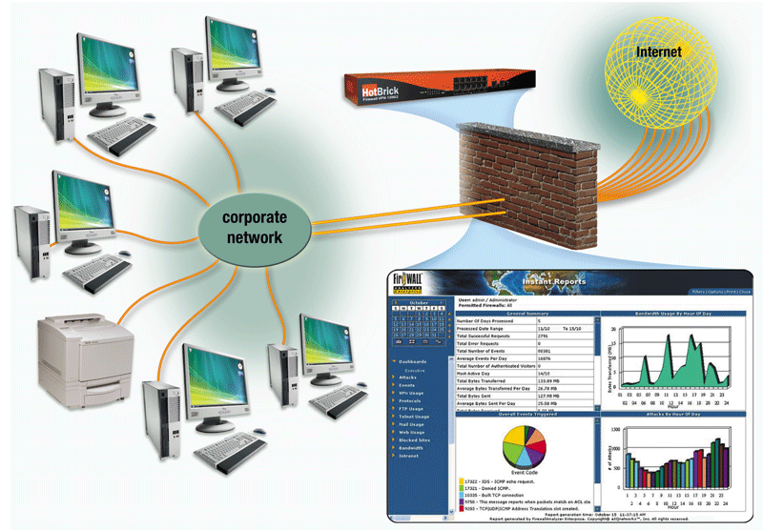

Slide 275
anti-virus program

Slide 276
How does an antivirus program inoculate a program file?
Records
information
about program such
as file size and
creation
date
Uses
information
to detect if
virus tampers
with file
Attempts
to remove
any detected
virus
Quarantines
infected
files that it
cannot
remove
Keeps file
in separate
area of hard disk

Slide 277
spyware

Slide 278
What are some tips for preventing virus, worm, and Trojan horse infections?
Never start a computer with removable media inserted
Install an antivirus program on all of your computers
Never open an
e-mail attachment unless you are expecting it and
it is from a
trusted source
If the antivirus program flags an
e-mail attachment
as infected, delete
the attachment immediately
Check all
downloaded
programs for
viruses, worms,
or Trojan horses
Install a personal
firewall program

Slide 279
Encryption

Slide 280
Parity bit

Slide 281
most basic form of error checking

Slide 282
used to check that data has been transmitted accurately

Slide 283
added to every data unit so that are all either odd or even

Slide 284
not as effective as other methods

Slide 285
checksum

Slide 286
Each message is accompanied by a numerical value based on the number of set bits in the message

Slide 287
If not the same, the packet or message is re-sent

Slide 288
Picks up 99.7% of all errors

Slide 289
Storage Area network

Slide 290
Stores information in blocks

Slide 291
Network Area Storage (NAS)

Slide 292
Stores information in files

Slide 293
Ethics

Slide 294
Privacy

Slide 295
Privacy act

Slide 296
Personal information cant be onsold

Slide 297
Freedom of information act

Slide 298
Allows you to find out information about yourself

Slide 299
Spam act

Slide 300
Makes it illegal for people to send spam

Slide 301
information

Slide 302
internet

Slide 303
spyware

Slide 304
phishing
Scam in which a perpetrator
sends an official looking
e-mail that attempts
to obtain your personal and
financial information

Slide 305
software theft

Slide 306
hacking

Slide 307
information accuracy

Slide 308
Communications

Slide 309
Modem

Slide 310
converts digital signals to analog & vice-versa for transmission over a telephone line

Slide 311
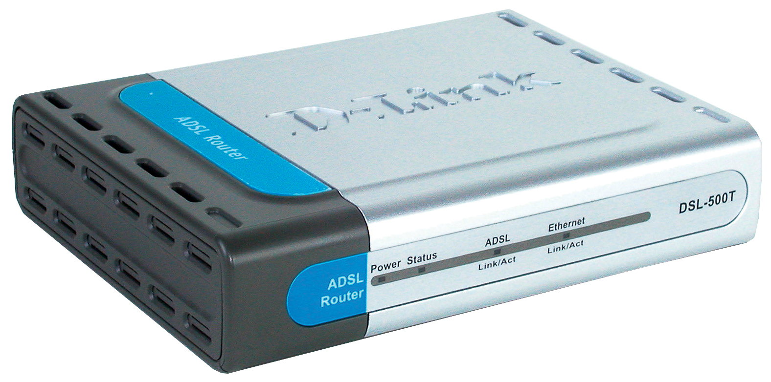
Modem

Slide 312
Bandwidth

Slide 313
the amount of data that can be transmitted via a given communications channel (eg, between a hard drive and the host PC) in a given unit of time

Slide 314
Microwaves

Slide 315
High frequency radio waves used for point to point & omnidirectional communication of audio, data & video signals

Slide 316
Is dependent on line of sight

Slide 317
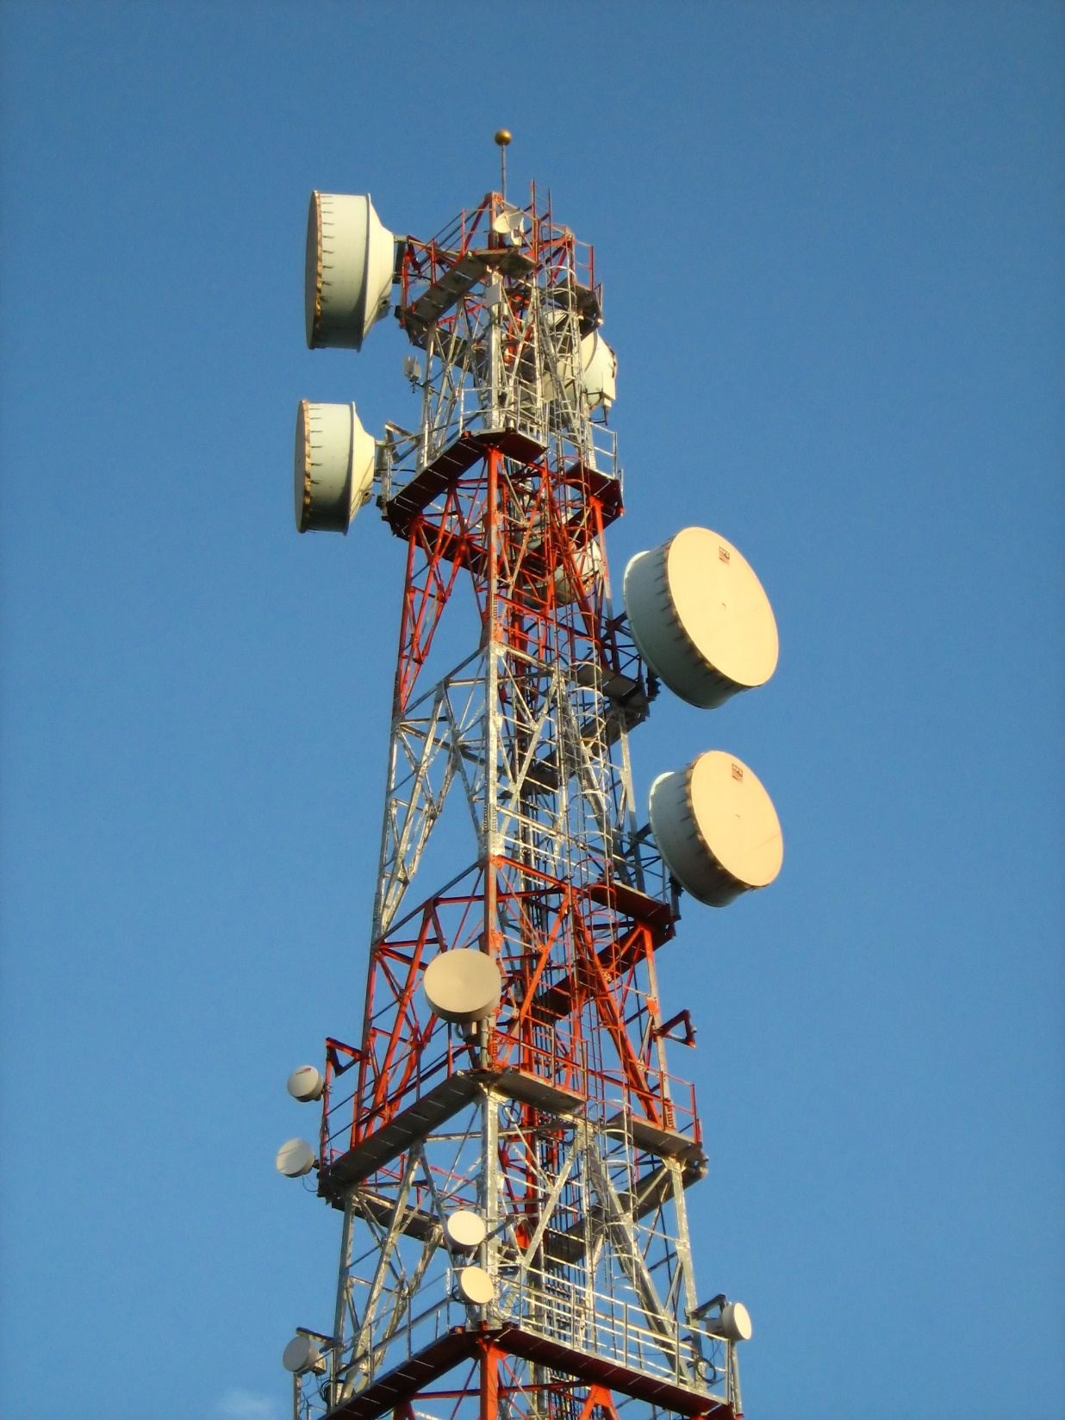
Networks

Slide 318
Satellite

Slide 319

Networks

Slide 320
Sophisticated electronic communications relay station orbiting 22,237 miles above the equator

Slide 321
moving in a fixed orbit

Slide 322
same speed and direction of the earth

Slide 323
Standards

Slide 324
802.3

Slide 325
ethernet standard

Slide 326
CSMA/CD
Carrier Sense Multiple Access/Collision Detection

Slide 327
802.5

Slide 328
token ring standard

Slide 329
IBM

Slide 330
802.11

Slide 331
wireless standard

Slide 332
802.11g

Slide 333
up to 54 Mbps

Slide 334
2.4 Ghz frequency

Slide 335
2nd most recent standard after 802.11n

Slide 336
Most recent 802.11ac

Slide 337
If given the choice, use 802.11ac

Slide 338
Noise

Slide 339
unwanted electrical interference

Slide 340
signal wire

Slide 341
electrical wires

Slide 342
radio waves

Slide 343
Attenuation

Slide 344
decrease in signal over 2 points

Slide 345
repeaters

Slide 346
digital network

Slide 347
a network that incorporates both digital switching and digital transmission

Slide 348
cellular network

Slide 349
radio network made up of a number of radio cells (or just cells) each served by a fixed transmitter

Slide 350
LAN

Slide 351
local area network

Slide 352
same geographical location

Slide 353
doesn’t cross public streets

Slide 354
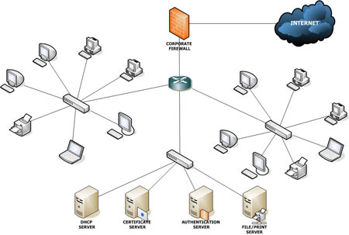

Slide 355
WAN

Slide 356
wide area network

Slide 357
can cover the globe

Slide 358
internet

Slide 359
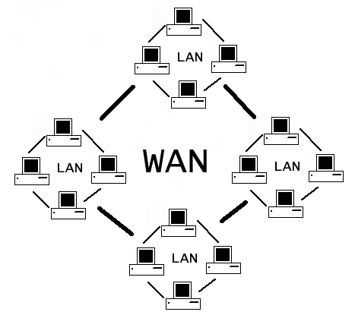

Slide 360
TCP/IP Model

Slide 361
4 layers

Slide 362
Link

Slide 363
Device driver and interface card which maps to the data link and physical layer of the OSI model.

Slide 364
Network

Slide 365
corresponds to the network layer of the OSI model and includes the IP Protocol

Slide 366
Transport

Slide 367
corresponds to the transport layer and includes the TCP and UDP protocols

Slide 368
Application

Slide 369
corresponds to the OSI Session, Presentation and Application layers and includes FTP, Telnet, SMTP, DNS, your program, etc

Slide 370
Storage Area Network (SAN)

Slide 371
connects multiple servers to a centralized pool of disk storage

Slide 372
by treating all the company's storage as a single resource, disk maintenance and routine backups are easier to schedule and control

Slide 373
Internet

Slide 374
Global system

Slide 375
interconnected networks

Slide 376
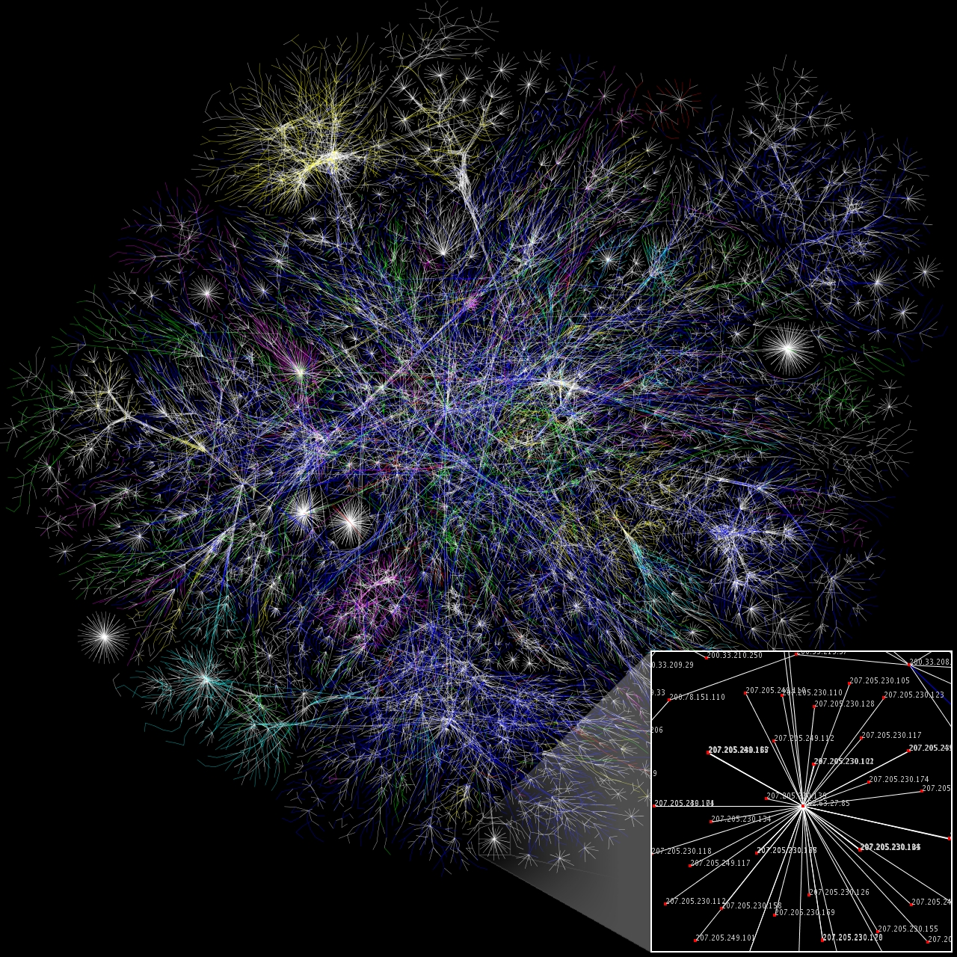

Slide 377
uses standardised TCP/IP

Slide 378
Structure

Slide 379
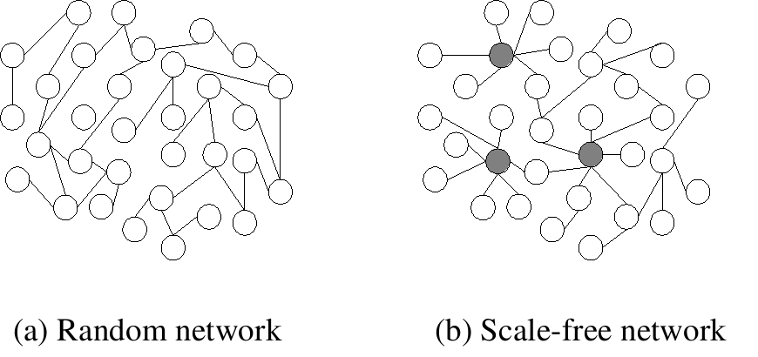

Slide 380
Domain Name Server

Slide 381
Server

Slide 382
manages network resources

Slide 383
responds to requests from clients

Slide 384
Topologies

Slide 385
way of laying out a network

Slide 386
bus

Slide 387
cheap to install

Slide 388
doesn’t require much cabling

Slide 389
gets congested with too many nodes

Slide 390
Ok for small lans

Slide 391
not good for schools

Slide 392
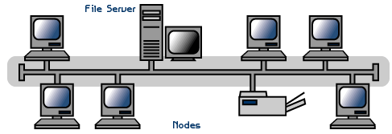

Slide 393
star

Slide 394
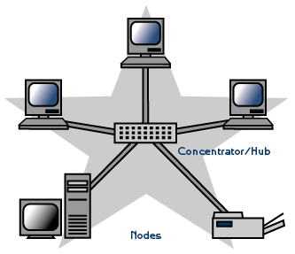

Slide 395
central connection point

Slide 396
if a cable fails, only 1 node fails (unless it’s the server)

Slide 397
prone to traffic bottlenecks

Slide 398
ring

Slide 399
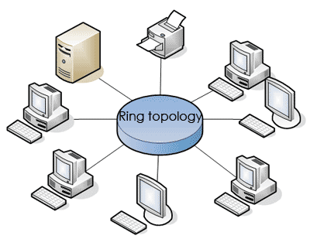

Slide 400
rarely used today

Slide 401
each node connect to 2 others

Slide 402
failure of a single node can fail network

Slide 403
Ethernet – 10Base-huh?
10Base-T=twisted pair (e.g. UTP). 10Mbps, max length 100m, RJ45 connectors.
10Base2 = uses thin coaxial (RJ58) cable – max length 195m. 10 Mbps. BNC connectors.
10Base5 = uses thick coaxial – max length 500m. Used mainly for backbones, cable TV.
10Base-F – fibre optic cable on 10Mbps networks – can get up to 2,000 megabits/sec (2Gbps) on the right network.
10Base-35 – broadband coaxial cable. Max length 3,600m.

Slide 404
gateway

Slide 405
acts as an entrance point to another network

Slide 406
can use different systems and convert

Slide 407
Dynamic Host Control Protocol (DHCP)

Slide 408
Allocates IP addresses to machines on a network

Slide 409
Packet Switching

Slide 410
Any protocol that breaks files into packets is called packet switching eg: TCP/IP

Slide 411
Internet Addressing
Humans like working with names (e.g. www.microsoft.com) but computers use IP numbers (e.g. 10.77.91.19).
IP address has four ‘octets’ separated by dots, each octet can be between 0 and 255.
Remember - all internet communications use IP addresses, not URLs. Only humans use URLs.

Slide 412
Computer Architecture

Slide 413
Central Processing Unit (CPU)

Slide 414
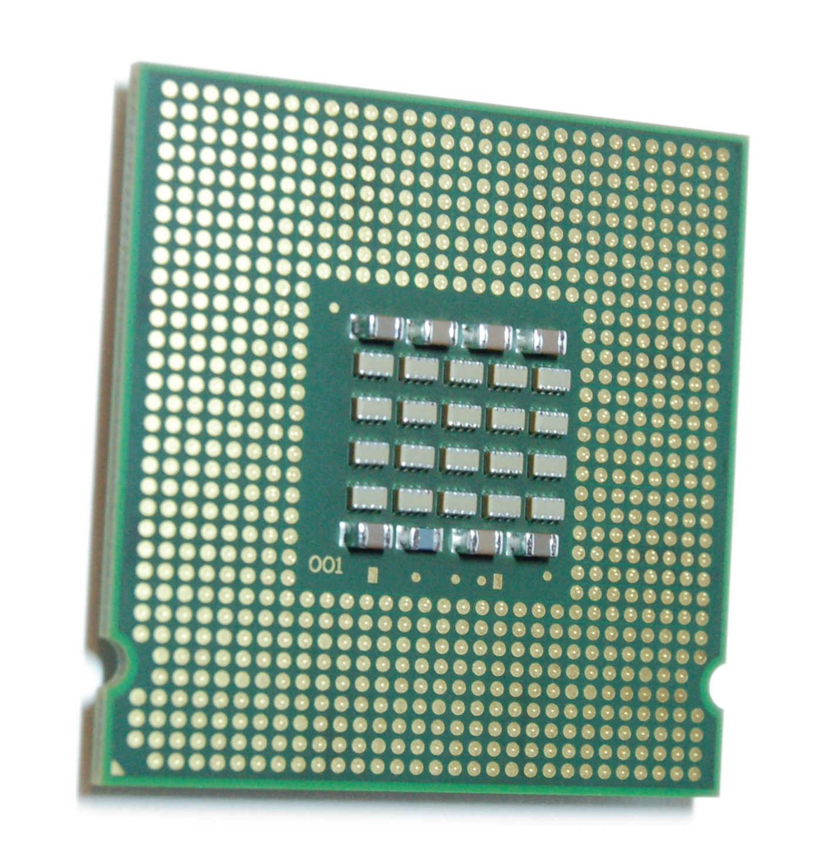

Slide 415
control unit

Slide 416
registers

Slide 417
Fast short term memory

Slide 418
Know at least 1 type of register (program counter)

Slide 419
arithmetic logic unit (ALU)

Slide 420
Calculates math and logic

Slide 421
RAM

Slide 422
Short term memory

Slide 423
volatile

Slide 424
Buses

Slide 425
Data, control, address

Slide 426
Moves information between parts

Slide 427
USB

Slide 428
Universal Serial Bus

Slide 429
a protocol for transferring data to and from digital devices

Slide 430
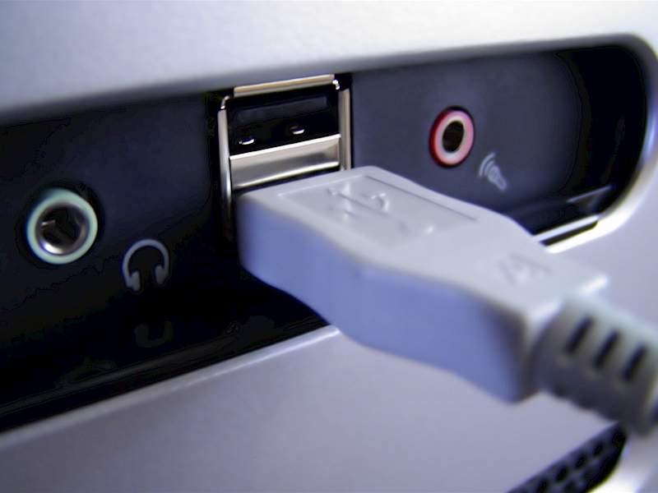

Slide 431
SCSI

Slide 432
small computer system interface

Slide 433
interface that serves as an expansion bus that can be used to connect hard disk drives, tape drives, and other hardware components

Slide 434
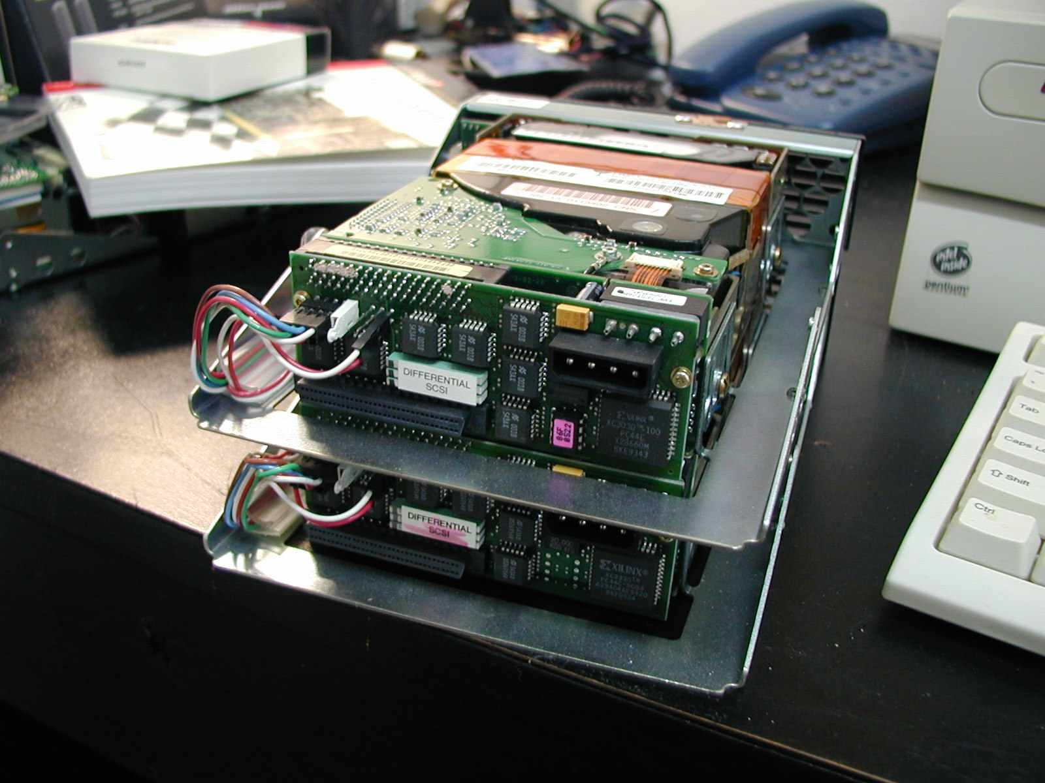

Slide 435
RAM

Slide 436
random access memory

Slide 437
memory that allows any storage location to be accessed randomly

Slide 438
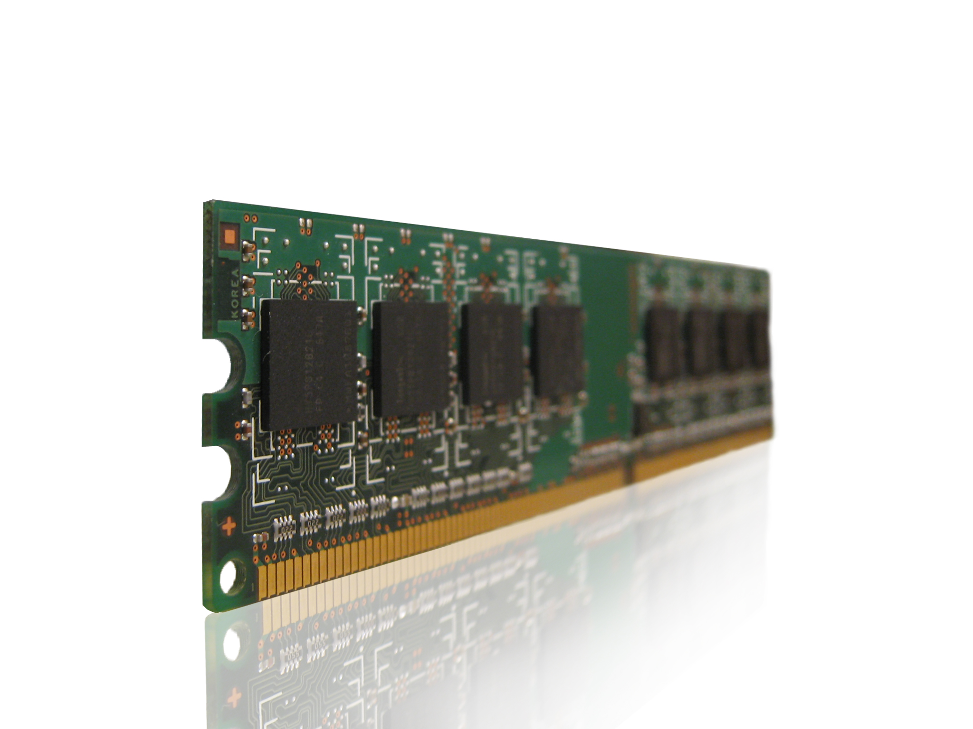

Slide 439
ROM

Slide 440
read only memory

Slide 441
memory whose contents can be accessed and read but cannot be changed

Slide 442
Caching

Slide 443
block of high speed memory where data is copied when it is retrieved from the RAM

Slide 444
located on CPU

Slide 445
level 2

Slide 446
Also located on CPU

Slide 447
level 3

Slide 448
Usually located on a hard drive

Slide 449
RISC

Slide 450
reduced instruction set computing

Slide 451
small number of assembly instructions

Slide 452
each of which performs simple operations, 1 clock cycle per instruction

Slide 453
CISC

Slide 454
complex instruction set computing

Slide 455
large number of often complex assembly instructions, takes more than 1 clock cycle

Slide 456
Fetch-Execute Cycle

Slide 457
fetch

Slide 458
decode

Slide 459
execute

Slide 460
store

Slide 461


What is a fetch-execute/machine cycle?
  Four operations of the CPU comprise a machine cycle
Step 1. Fetch
Obtain program instruction or data item from memory
Memory
Step 2. Decode
Translate instruction into commands
Step 4. Store
Write result to memory
Processor
ALU
Control Unit
Step 3. Execute
Carry out command

Slide 462
Sequential Processing
all processing on a single processor computer

Slide 463
Parallel Processing
to process data more quickly,
more processors can be added
to the system

Slide 464
Distributed Processing

Slide 465
Spread across a range of machines to improve processing speeds

Slide 466
Multicore

Slide 467
Multiple cores on 1 CPU to improve processing speed

Slide 468
Troubleshooting

Slide 469
Preventative Maintenance

Slide 470
defragmentation

Slide 471
clear temp files

Slide 472
back up

Slide 473
full

Slide 474
all files are saved

Slide 475
time consuming

Slide 476
incremental

Slide 477
Only recent changes saved

Slide 478
even longer recovery time

Slide 479
virtualisation

Slide 480
partitioning one server into multiple servers

Slide 481
Saves time and money, less machinery, floor space and air-conditioning needed

Slide 482
Desktop, server, PC, Storage

Slide 483
Desktop

Slide 484
Think of computers at school where you can login to any machine and access your files

Slide 485
Server

Slide 486
All images are run from a virtual machine located on a server

Slide 487
PC

Slide 488
Run 2 operating systems on the same machine

Slide 489
Storage

Slide 490
pooling of physical storage from multiple storage devices into what appears to be a single storage device

Slide 491
convergence

Slide 492
combining technologies

Slide 493
concurrency

Slide 494
Appearance of simultaneous execution

Slide 495
File systems

Slide 496
Storing data

Slide 497
Creating folders and files

Slide 498
Space management

Slide 499
Drivers

Slide 500
Software that allows the hardware and software to talk to each other

Slide 501
RAID

Slide 502
Redundant Array of Independent Disks

Slide 503
RAID 0

Slide 504
striping

Slide 505
RAID 1

Slide 506
mirroring

Slide 507
RAID 10

Slide 508
Combination of both

Slide 509
Programming

Slide 510
interpreter

Slide 511
easier to write

Slide 512
Translate each line of code, then runs it

Slide 513
executes high level program directly

Slide 514
compiler

Slide 515
compiled code runs faster

Slide 516
translates the whole code first then runs it

Slide 517
turns high level program to machine language

Slide 518
Algorithms

Slide 519
An algorithm is a well-ordered collection of unambiguous and effectively computable operations that when executed produces a result

Slide 520
Structure Chart

Slide 521
diagram showing the relationship between modules

Slide 522
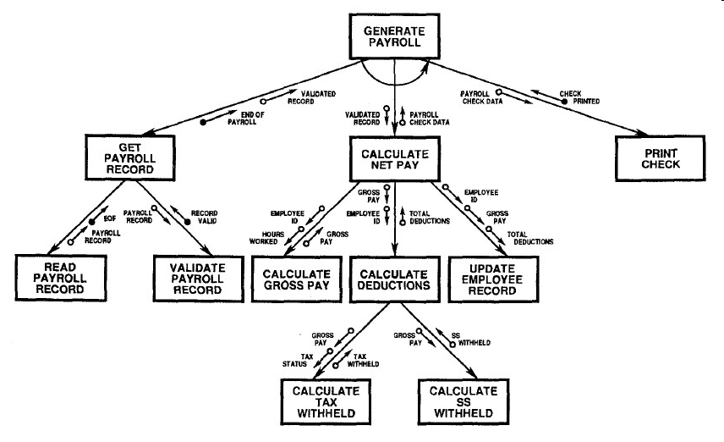

Slide 523
Programming

Slide 524
sequence

Slide 525
step by step

Slide 526
selection

Slide 527
if

Slide 528
then

Slide 529
else

Slide 530
case

Slide 531
iteration

Slide 532
for next

Slide 533
Set number of repetitions

Slide 534
do while

Slide 535
Test first

Slide 536
repeat until

Slide 537
Test last

Slide 538
modules

Slide 539
parameters

Slide 540
Value and reference

Slide 541
Value = copy of the parameter and won’t change the main value

Slide 542
Reference = the parameter and will change in the main value

Slide 543
functions

Slide 544
Similar to a module but will only return a single value to the main program

Slide 545
variable

Slide 546
A location used for storing data in memory for later use

Slide 547
constant

Slide 548
a value that never changes throughout the life of the program

Slide 549
arrays

Slide 550
way to manage data of similar types

Slide 551
referenced directly by means of an index

Slide 552
records

Slide 553
group of fields that go together but are of different data types

Slide 554
Programming errors

Slide 555
syntax

Slide 556
detected by compiler

Slide 557
grammar violations

Slide 558
logic

Slide 559
detected & corrected by programmer

Slide 560
output doesn’t match expected output

Slide 561
run-time

Slide 562
program terminates unexpectedly

Slide 563
discovered by user, corrected by programmer

Slide 564
usually based on a logic error

Slide 565
Type Checking

Slide 566
Data

Slide 567
Data = for example, is the data a string or integer

Slide 568
Range

Slide 569
Range = is the month between 1 and 12 for example

